Slide 1
AI-DRIVEN BENCH MANAGEMENT AND WORKFORCE ALLOCATION
•“FROM REACTIVE STAFFING TO PROACTIVE AI-DRIVEN WORKFORCE INTELLIGENCE.”
Team Name: Tech Topians
Team members : Poorva Wakade, Siddhi Shejwal, Astha Nakat, Vaishnavi Chaudhari, Shweta Patil, Samiksha Vaishnav, Riya tavhare.
College: Bharati Vidyapeeth College of Engineering for Women

Slide 2


PROBLEM STATEMENT
Large IT consulting firms manage thousands of employees across multiple projects.
Workforce allocation is often handled using spreadsheets or fragmented systems.
Limited visibility of employee availability leads to increased bench time.
Bench employees increase operational costs and reduce overall productivity.
Workforce planning becomes difficult due to scattered data and tight staffing deadlines.
There is a need for an AI-driven system to predict bench risks and optimize workforce allocation.

Slide 3
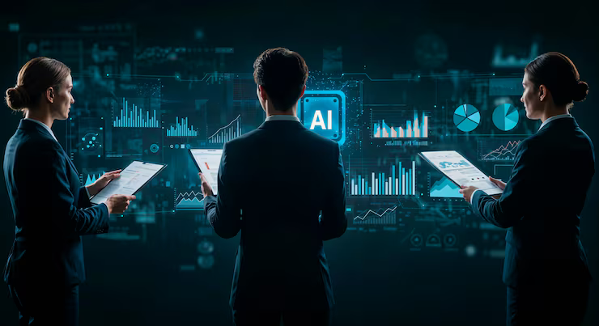
TARGET USERS
Primary Users
HR Managers – Manage employee skills
Resource Managers – Allocate employees to projects
Project Managers – Select suitable employees
Talent Teams – Identify skill gaps
Business Heads – Monitor workforce utilization
Usage Scenarios
Project team formation
Workforce allocation
Project lifecycle management

Slide 4
PROPOSED AI SOLUTION
Bench Time Fixer is an AI-driven workforce intelligence platform designed to optimize bench management, workforce allocation, and skill forecasting in IT consulting organizations.
Key Inputs:
AI Proce s sing & Models:
1
• Employee Data
• Project Requirements
• Historical Workforce Data
2
• Employee–Project Matching
• Bench Risk Prediction
• Skill Demand Forecasting
• Training Recommendation Engine
• Cost Optimization
3
Advance Capabilities
• Predictive Hiring
• Dynamic Workforce Allocation
• Market Trend Analysis

Slide 5
PROPOSED AI SOLUTION
4
System Output
• Best employee
• Bench risk alerts (Low / Medium / High)
• Personalized training recommendations
• Cost-optimized team suggestions and intern allocation
• Hiring forecasts for future project demands
5
Business Impact
• Faster formation of project-ready teams
• Reduced bench time and improved workforce utilization
• Data-driven hiring and training decisions
• Lower operational costs and higher productivity

Slide 6

AI TECHNIQUES USED
Employee–Project Matching – Skill embeddings + cosine similarity
Bench Risk Prediction – Random Forest, XGBoost
Skill Demand Forecasting – ARIMA, Prophet, LSTM
Training Recommendations – Collaborative filtering
Cost Optimization – Linear / Integer programming
Advanced Capabilities – Predictive hiring & dynamic workforce allocation 🚀

Slide 7
TECHNOLOGY STACK
•Frontend* HTML, CSS, JavaScript* React
•Backend* Python* Flask
•Machine Learning* Scikit-learn* Pandas* NumPy
•Database* CSV-based employee dataset
•Development Tools* VS Code* GitHub

Slide 8
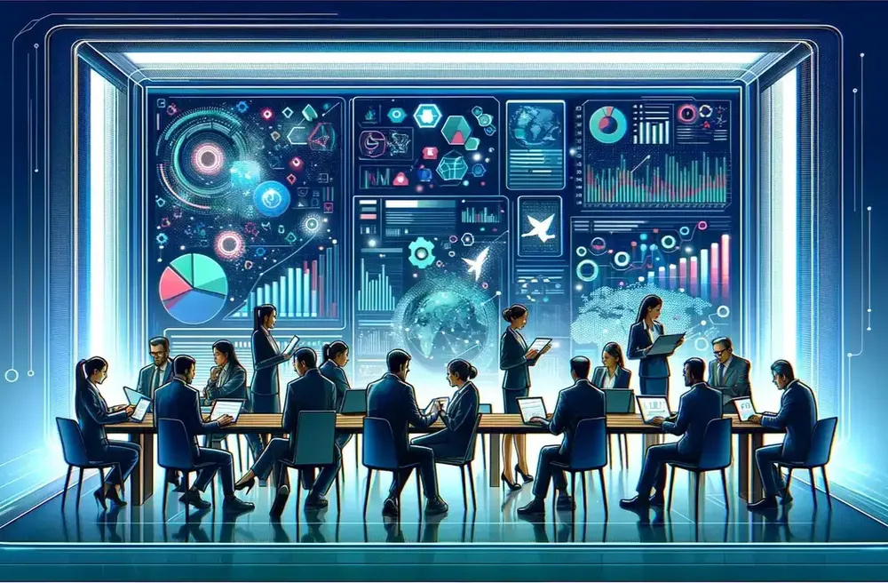
KEY FEATURES
AI Skill Matching Engine – Matches employees to projects using skill similarity
Bench Time Prediction – Predicts employee bench risk levels
Workforce Digital Twin – Simulates future workforce scenarios
AI Workforce Health Score – Measures overall workforce performance
Project Success Predictor – Predicts project success probability
Skill Demand Scanner – Identifies emerging skills and trends
HR Analytics Dashboard – Shows workforce insights and utilization
AI HR Chatbot – Helps managers query workforce data quickly

Slide 9
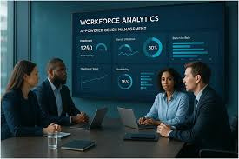
MARKET RESEARCH
Large IT firms manage thousands of employees across projects
Efficient workforce allocation reduces bench time and costs
Existing AI Talent Platforms: Gloat, Eightfold.ai
Workforce Intelligence Tools: SkyHive, iMocha

Slide 10
INNOVATION
Bench Time Fixer
Skill Matching – Best-fit staffing
Bench Prediction – Forecast idle time
Smart Utilization – Training & mentoring options
Explainable AI – Transparent decisions
Future Skills – AI, Cloud, Cybersecurity trends
HR Assistant – Conversational team planning
Innovation: From reactive to proactive workforce planning in one AI-driven platform.

Slide 11
RESPONSIBLE AI
Reduced Bench Time – From ~45 days to ~20 days
Better Workforce Utilization – Skill-based employee allocation
Lower Operational Costs – Reduced idle resources
Efficient Project Staffing – Faster candidate selection
Intern Opportunities – Smart internship allocation
Data-Driven Decisions – AI-based workforce insights
.

Slide 12
IMPACT & BENEFITS
AI Workforce Planning
Bench ↓: 45 → 20 days
Utilization ↑: Skills + availability match
Costs ↓: Less idle time
Staffing ↑: Faster candidate fit
Interns ↑: Smart allocation
Decisions ↑: Data-driven HR

Slide 13
ENHANCEMENTS
Smart Workforce Tools
Mobile App: Manager access on the go
Email Alerts: Bench & staffing updates
HR Integration: Seamless data sync
Skill Forecasting: Predict future needs

Slide 14

CONCLUSION
AI Workforce Management
Smart Staffing: AI skill matching & predictive analytics
Bench Risk Alerts: Early identification & proactive planning
Data Insights: Better HR & training decisions
Efficiency Boost: Higher utilization & productivity
Future‑Ready: Reduced bench time, optimized allocation, stronger strategy

Slide 15
THANK YOU

